Slide 1
Loops
Brandon Krakowsky

Slide 2
Flow Control: Loops

Slide 3
Loops
Used to repeat a process (block of statements) or perform an operation multiple times
for loops
Run a piece of code for a given number of times
while loops
Run a piece of code indefinitely while a condition is met

Slide 4
for Loops
A for loop executes code a given number of times
To do this, it iterates over a list
numbers = [1, 2, 3, 4, 5, 6, 7, 8, 9, 10] for number in numbers:
print(number) - The for line indicates how many times the code will run - number is a “dummy” variable that refers to the element in the list that we're passing through

Slide 5
for Loops
We can iterate over the same list and find the numbers that are even
numbers = [1, 2, 3, 4, 5, 6, 7, 8, 9, 10]
even_numbers = []
for number in numbers:
if (number % 2 == 0):
even_numbers.append(number)
print(even_numbers)
- We initialized an empty list outside of the loop, then populated (appended) to the list as we iterated over the data

Slide 6
for Loops
We can get a count of the even numbers by incrementing a count
numbers = [1, 2, 3, 4, 5, 6, 7, 8, 9, 10]
even_numbers = [] even_count = 0
for number in numbers:
if (number % 2 == 0):
even_numbers.append(number) even_count += 1
print(even_numbers)
print(“There are”, even_count, “numbers in the even list”)
Here’s another way to get the count of even numbers print(len(even_numbers))

Slide 7
for Loops - Exercise
Write code that finds the minimum value of a list of numbers 5, 3, 8, -1, -2.2, 0
Don't use the built-in min() function
Instantiate a 'numbers' list variable containing the proper values (above)
Iterate over that list and find the min value
Print the minimum value in the format: "... is the min number”
numbers = [5, 3, 8, -1, -2.2, 0]
min_number = numbers[0]
for number in numbers:
if number < min_number:
min_number = number print(min_number, "is the min number")

Slide 8
for Loops
You can iterate over lists of strings
planets = ['Sun', 'Mercury', 'Venus', 'Earth', 'Mars’]
for planet in planets:
if (planet == 'Sun'):
print(planet, "is not a planet”)
else:
print(planet, "is a planet”)
if (planet == 'Mercury'):
print(planet, "is closest to the Sun")

Slide 9
for Loops
You can also iterate over strings themselves!
month = "February”
print(month, "is spelled: ”)
for x in month:
print(x)

Slide 10
for Loops - Exercise
Prompt the user for their first name
Using a for loop
Print each letter of the name (on the same line)
Count each letter in the name
Print the count of letters in the name
name = input("What is your first name?”)
letter_count = 0
print(name, "is spelled:”)
for x in name:
print(x, end = ‘ ’)
letter_count += 1
print("There are", letter_count, "letters in", name)

Slide 11
for Loops Using range
The range function generates a sequence (range) of numbers
This can be used, like a list, when you want to perform an action n number of times
Format: range(start, up_to, step)
start and step are both optional
up_to means “up to but not including” the value
can only use integers! (no floats)
Iterates over a sequence of 10 numbers, from 0 – 9
for x in range(10):
print(x)
This also iterates over a sequence of 10 numbers, from 0 – 9
for x in range(0, 10):
print(x)

Slide 12
for Loops Using range
Iterates over a sequence of 6 numbers, from 1 – 6
for x in range(1, 7):
print(x)
Iterates over a sequence of 5 numbers, from 0 – 28, skipping every 6 numbers for x in range (0, 30, 7): print(x)
Iterates over a sequence of 6 numbers, counting backwards from 5 – 0 for x in range (5, -1, -1): print(x)

Slide 13
for Loops Using range
Here we find the numbers between 1 and 1200 that are odd
odd_numbers = []
for number in range(1, 1201):
if (number % 2 != 0):
odd_numbers.append(number)
print(odd_numbers)

Slide 14
for Loops – List Comprehension
Another way to add items to a new list is by using list comprehension
It consists of an expression followed by a for loop inside square brackets []
Meaning: Do something for each iteration of the loop and add the result to a new list
Using list comprehension, find the numbers between 1 and 1200 that are odd odd_numbers = [num for num in range(1, 1201) if num % 2 != 0] print(odd_numbers)
For each number in the range 1 – 1200, where the number is odd, append to a new list named odd_numbers. Print the new list.

Slide 15
while Loops
A while loop repeatedly executes code based on a condition
Be careful -- if the condition is never met, your loop becomes an infinite loop and never stops
If this happens, your program could crash!
This prints the value of a until it reaches 0 a = 5 while (a > 0): print("a is being decremented:", a) a -= 1
Here’s a program that multiplies x by 2 until an upper limit of 128, starting at 4 x = 4 while (x < 128): x = 2 * x print("x is now:", x)

Slide 16
while Loops – Getting User Input
One use case for a while loop is a program that needs to continuously run and “wait” for something to happen, like specific user input
This program runs until the user says ‘hello’ inp = input('Hi! Please say hello.’) while inp != 'hello’: inp = input('Please say hello.’) print('It\'s about time!')

Slide 17
while Loops - Exercise
Write a program that uses a while loop to test user input of a secret password.
If the user inputs "secret”, print “Welcome!” and exit the program
Otherwise, print “Sorry, the password you entered is incorrect. Please try again.” and prompt the user again
password = ""
while password != "secret":
password = input("Please enter the password:")
if password == "secret":
print("Welcome!")
else:
print("Sorry, the password you entered is incorrect. Please try again.")

Slide 18
Exit a Loop Using break
break exits the entire loop immediately
This prints 1- 4 only x = 1 while x <= 10: if x == 5: break #this exits the entire while loop! print(“x is now:”, x) x += 1

Slide 19
Exit a Loop Using continue
continue changes the flow of control and exits the current loop only
This prints all of the odd numbers between 1 - 20, except those that are multiples of 3
for number in range(1, 21):
if (number % 2 != 0):
if (number % 3 == 0): continue #this exits the current iteration of the for loop only print(number)

Slide 20
Nested Loops
A nested loop is a loop within a loop!
For every iteration of the outer loop, it runs the inner loop
What does the following code print?
for i in range(1, 4): print('i:', i) for j in range(1, 3): print('\t', 'j:', j)

Slide 21
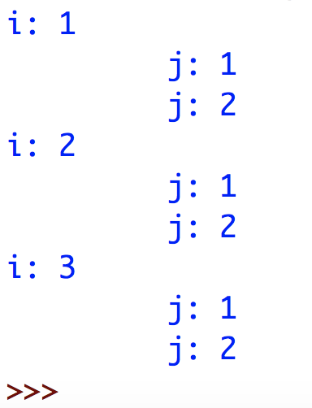
Nested Loops
A nested loop is a loop within a loop!
For every iteration of the outer loop, it runs the inner loop
What does the following code print?
for i in range(1, 4): print('i:', i) #for each number i for j in range(1, 3): #for each number j print('\t', 'j:', j)

Slide 22
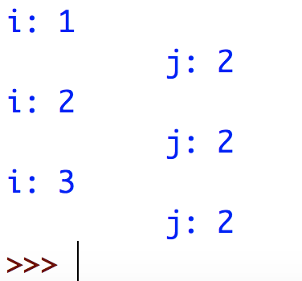
Nested Loops
A nested loop is a loop within a loop!
For every iteration of the outer loop, it runs the inner loop
What does the following code print?
for i in range(1, 4): print('i:', i) #for each number i for j in range(1, 3): #for each number j if (j <= 1): #continue to next iteration of current loop continue print('\t', 'j:', j)

Slide 23
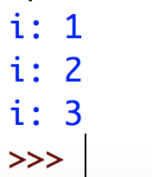
Nested Loops
A nested loop is a loop within a loop!
For every iteration of the outer loop, it runs the inner loop
What does the following code print?
for i in range(1, 4): print('i:', i) #for each number i for j in range(1, 3): #for each number j if (j <= 1): #break out of current loop only break print('\t', 'j:’, j)

Slide 24
Nested Loops – Multiplication Table Exercise
Let’s just make sure we know our multiplication tables for i in range(1, 11): #for each number i (1 – 10)
for j in range(1, 11): #iterate over each number j (1 – 10) print ("{} * {} = {}".format(i, j, i * j)) #multiply and print

Slide 25
Example Programs

Slide 26
Average Program
Write a program that asks the user for numbers (ints). It computes the average of the numbers. Allows the user to enter -1 to quit the program. num_list = [] i = 0 playing = True #set up loop to repeatedly get user input of an int while (playing == True): num = int(input("Enter num: ")) if (num == -1): #if the user inputs -1, this code will eventually exit the loop playing = False num_list.append(num) i += 1

Slide 27
Average Program
Write a program that asks the user for numbers (ints). It computes the average of the numbers. Allows the user to enter -1 to quit the program. num_sum = 0 for num in num_list: num_sum += num #calculate the average num_avg = num_sum / i print("avg:", num_avg)

Slide 28
Average Program
What’s wrong with this program?
We’re appending -1 (to exit the program) to our list of numbers in our loop #set up loop to repeatedly get user input of an int while (playing == True): num = int(input("Enter num: ")) if (num == -1): #if the user inputs -1, this code will eventually exit the loop playing = False num_list.append(num) i += 1

Slide 29
Average Program
What’s wrong with this program?
We’re appending -1 (to exit the program) to our list of numbers in our loop
Here’s the fix! #set up loop to repeatedly get user input of an int while (playing == True): num = int(input("Enter num: ")) if (num == -1): #if the user inputs -1, this code will eventually exit the loop playing = False else: num_list.append(num) i += 1

Slide 30
Multiplication Table Program
Write a program that asks the user for a number, then prints out the multiplication table. #ask the user for a number num = int(input('give me a num please: ')) #create a range of numbers 0 – 9 for i in range(10): #complete (and print) each multiplication problem (e.g. 3 x 1 = 3) print(str(num) + ' x ' + str(i + 1) + " = " + str(num * (i + 1)))

Slide 31
Word Reversal Program
Write a program that reverses a word. string = ’pasta’ rev = ‘’ #Iterates over a sequence, counting backwards from len(string) - 1 to 0 #with a step of -1 for j in range(len(string) - 1, -1, -1): rev += string[j] print(rev)

Slide 32
Palindrome Program
Write a program that asks the user for a string, then reverses it and checks if it’s a palindrome (a word that reads the same backward as forward)
Example: racecar
#ask the user for a string pot_palin = input('give me string: ’) rev_palin = ‘’ #prepend each character to the beginning of a new word for char in pot_palin: rev_palin = char + rev_palin #check whether the reverse word is the same as the original if rev_palin == pot_palin: print(pot_palin, 'is a palindrome!’) else: print(pot_palin, 'is not a palindrome')

